Slide 1
Waveforms of VFDs
How to properly analyze the operation of a VFD by examining the voltage and current waveforms.
Jim Crook
Sr Staff Electrical Engineer

Slide 2
Overall Principles
Current always goes in a closed loop.
We should always look for the path back to the source
Voltages are always measured with respect to another portion of the circuit.
A picture is worth a thousand words (approximately)

Slide 3
Four areas of VFD Measurements
Input side
DC bus
Output side
Controls and Communications

Slide 4
Input Voltages and Currents

Slide 5
Typical Mains Topology: Solidly grounded Neutral
TN-Earthing (Grounding) System:
  Protective Earth (PE) Neutral (N) are Separate conductors
  They are connected together only near the power source.
L1
3 Phase transformer secondary
WYE connected
With Neutral Grounded
L2
L3
N
PE
PE
L1
L2
L3
N

Slide 6
Schematic of drive, input in green

Slide 7
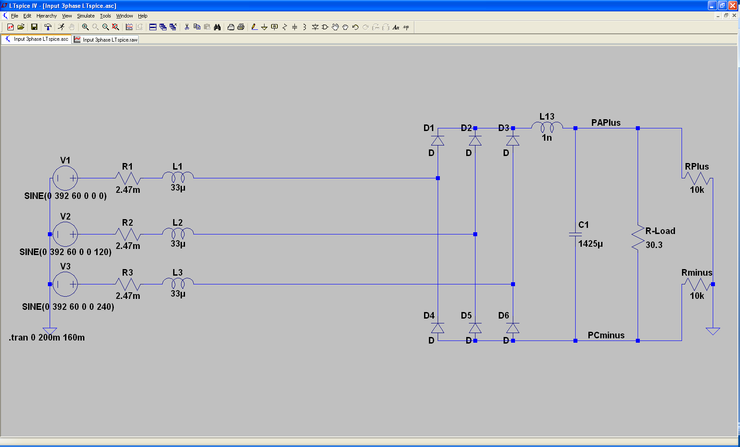
Simulation of 15 HP 460 V,
22 kA Prospective Short Circuit Current.

Slide 8
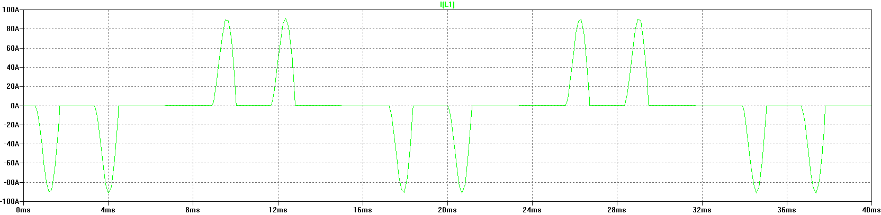
Input Current, Line 1
The current is a double pulse pattern. It only flows when the input voltage is higher than the dc bus.

Slide 9
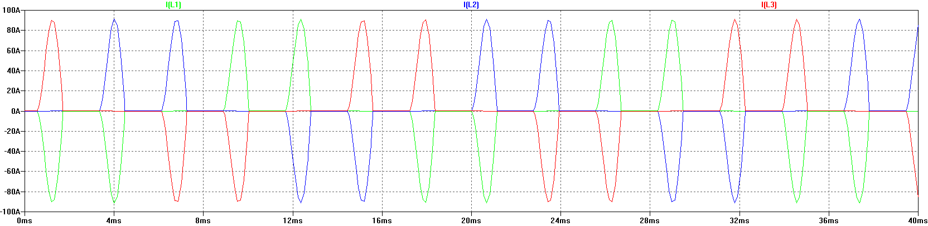
Input Current, Line 1, Line 2, and Line 3
There are six pulses per cycle, two from each phase.

Slide 10
Data Bulletin 8800DB0801
The Effects of Available Short-Circuit Current on AC Drives

Slide 11
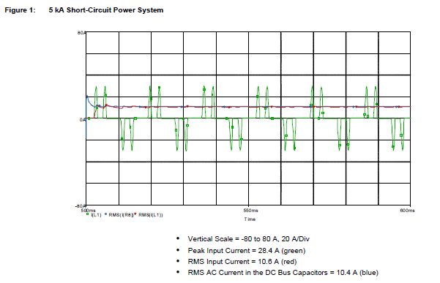
5 kA Prospective Short Circuit Current

Slide 12
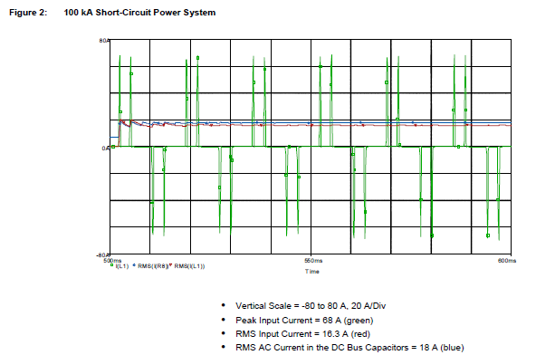
100 kA Prospective Short Circuit Current

Slide 13
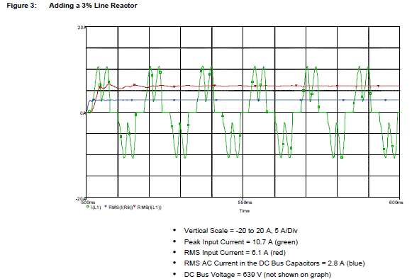
100 kA Prospective Short Circuit Current, but added line reactor

Slide 14
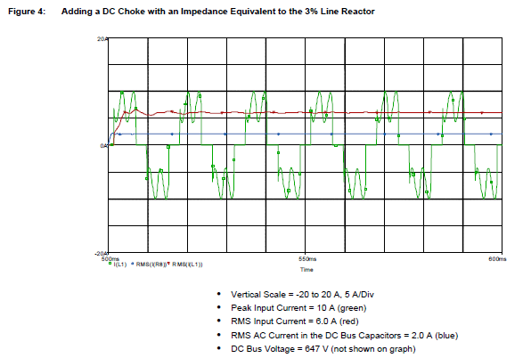
100 kA Prospective Short Circuit Current, but added dc choke

Slide 15
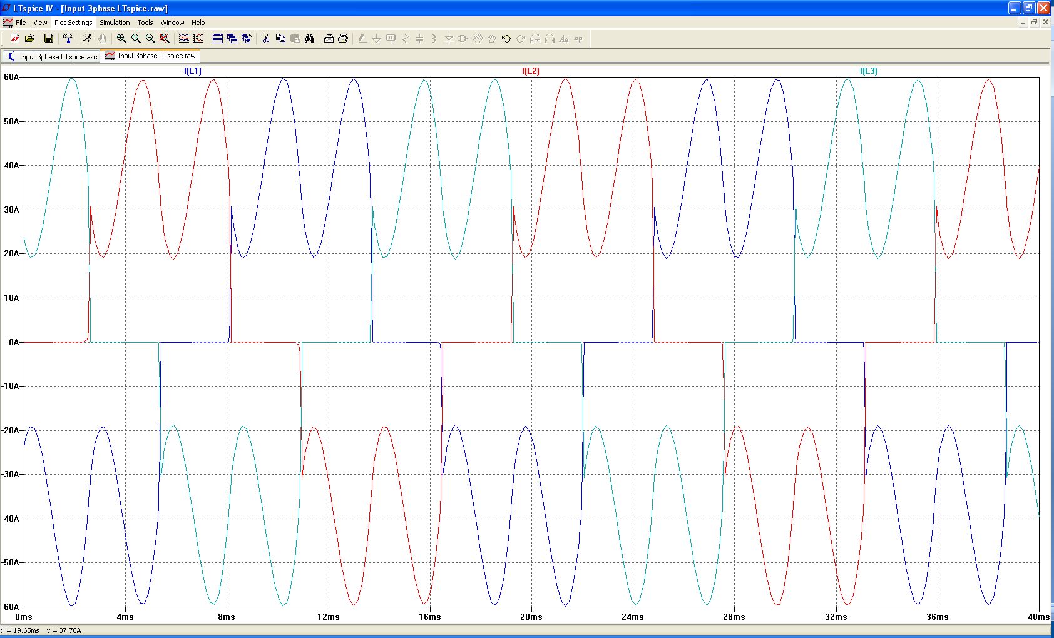
Drive with large dc choke.
The line currents have a leading edge and the current does not go to zero in the middle.
Notes:
DC chokes will have less voltage drop than the ac line reactor for the same amount of filtering. This is because the current does not need to go down to zero and then change direction. It can stay up around an average value.
A dc choke does not protect the input diodes, however.

Slide 16
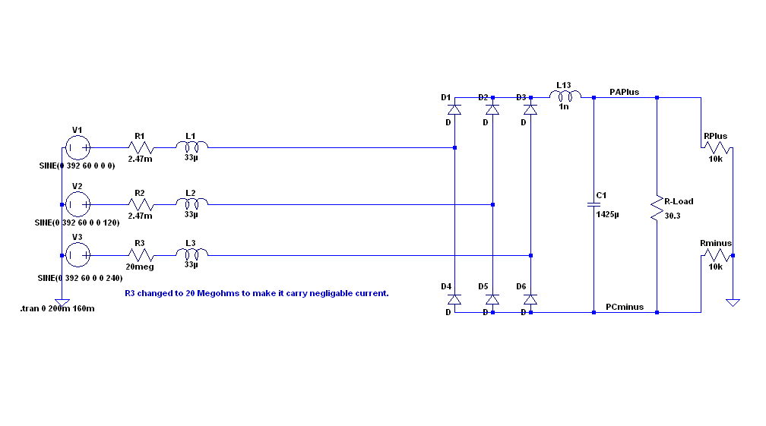
Simulation of 15 HP 460 V,
Single Phase input power.

Slide 17
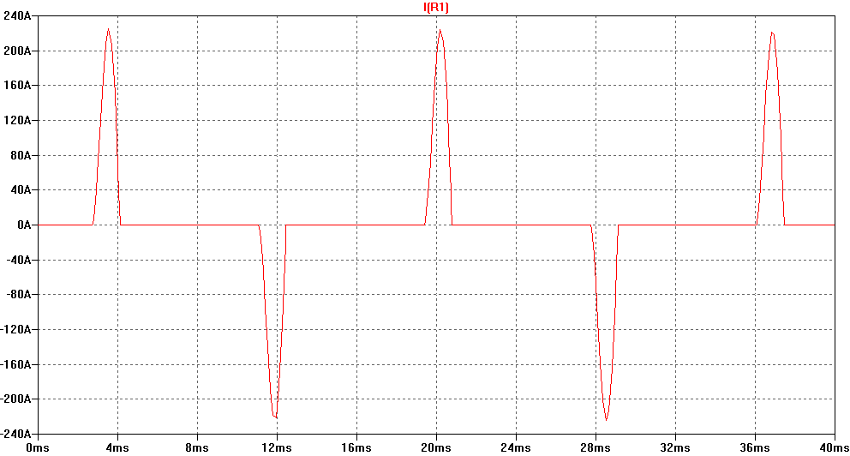
Single Phase Input Current
The current is a single pulse pattern. When rectified it has 8.33 ms between pulses.

Slide 18
Single Phase to 3 Phase comparison
Single Phase
Peak Current 230 A, about 2.5 times higher!
Time between pulses is 8.333 ms
DC bus ripple 110 V peak to valley.
Three Phase
Peak current 90 A
Time between pulses is 2.777 ms
DC bus ripple 20 V peak to valley
Single Phase input requires at least double sizing the drive to handle the higher input current and DC bus ripple. Some 480 V drives require adding additional capacitance plus double sizing the drive. Line reactors reduce the peak current; but also reduces bus V.

Slide 19
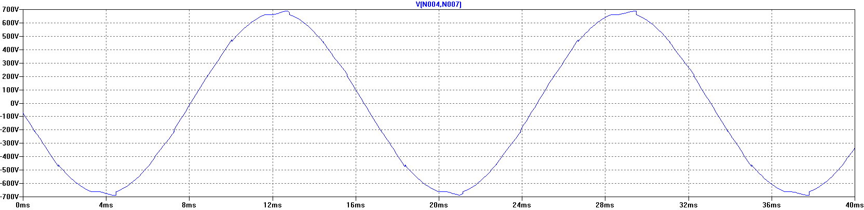
3 phase Input Voltage, Line 1 to Line 2.
The bumps are from the current peaks drawn by the drive. It is still basically sinusoidal, with peak voltages 650 V or higher.

Slide 20
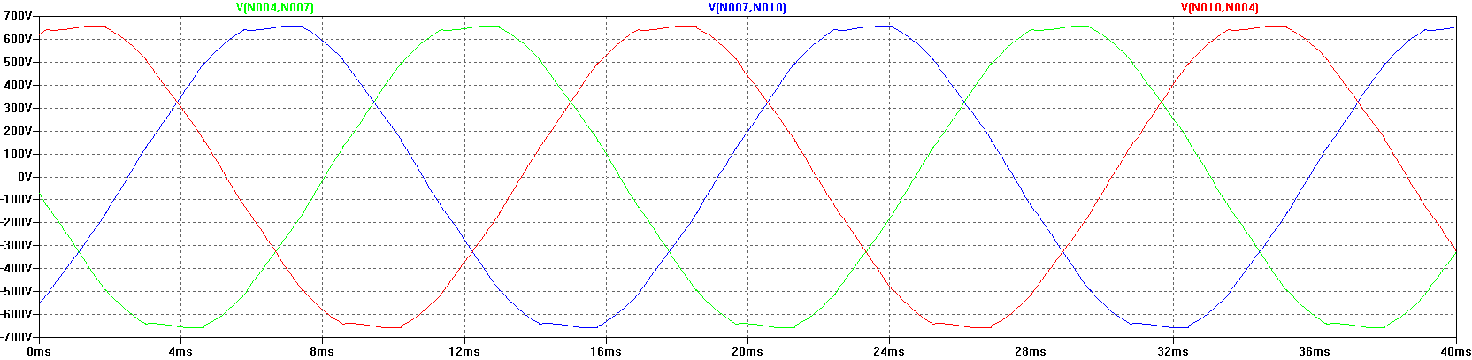
Input Voltage, Line 1 to Line 2.
Line resistance increased to 0.25 Ohms
(for this chart only). This causes
“Flat-Topping”
Peaks have been flattened by a voltage drop across the series impedance.
Voltage Distortion.
Causes Low dc bus voltage, and low motor voltage at full speed.

Slide 21
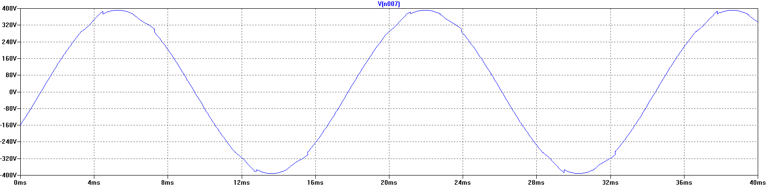
Input Voltage, Line 1 to Ground, 277 V,
22 kA PSCC
The bumps are from the current peaks drawn by the drive. It is still basically sinusoidal.

Slide 22
VFD dc bus voltages

Slide 23
Schematic of drive, dc bus in green

Slide 24
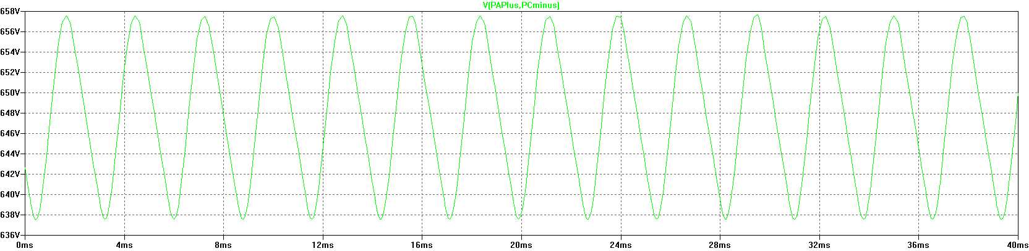
DC Bus voltage, Zoomed in
The dc bus charges up to the peak of the line to line voltage. When the current stops, the dc bus supplies the energy until the next current pulse comes.

Slide 25
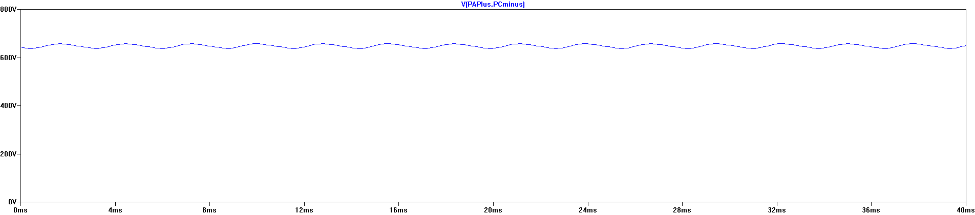
DC Bus Voltage, Scale 200 V / Division

Slide 26
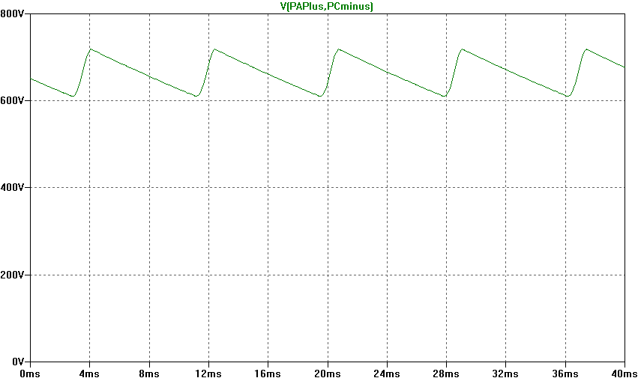
Single Phase input: DC Bus Voltage.
Note the ripple is much larger. More capacitance is needed by about 2 to 3 times.

Slide 27
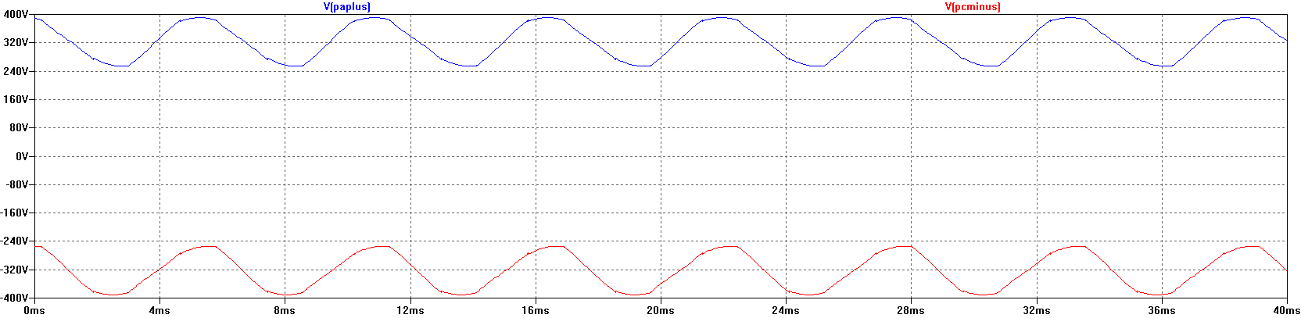
DC bus voltage with respect to ground.
The dc bus floats up and down with the average summation of the conducting phases.
The negative bus is NOT at ground.

Slide 28
Mains Topology
Corner grounded -System:
  This system still used in the U.S.
  It is not allowed for Y-range Altivar drives !
L1
L2
L3
PE
L1
L2
L3

Slide 29
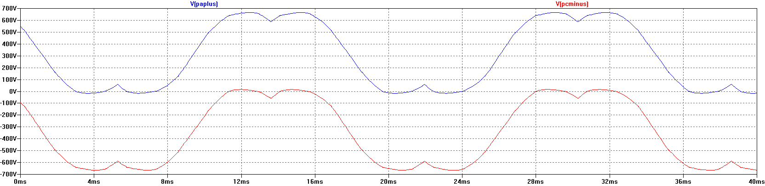
DC bus voltage with respect to ground,
Corner grounded Delta.
The dc bus floats up and down with the average summation of the conducting phases.
The negative bus is NOT at ground.
This also causes more capacitive current on the motor leads.

Slide 30
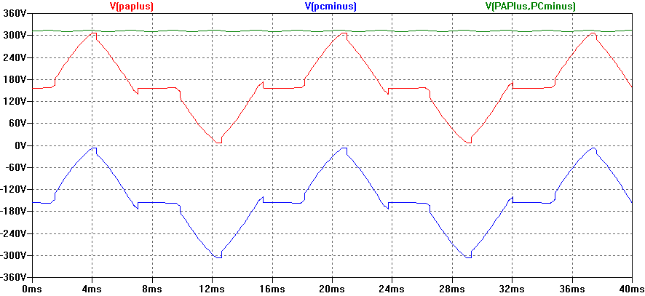
DC bus voltage with respect to ground,
High Leg Delta.
The dc bus floats up and down with the average summation of the conducting phases.
The negative bus is NOT at ground.
This also causes more capacitive current on the motor leads.

Slide 31
VFD Output voltages

Slide 32
Schematic of drive, Output IGBTs

Slide 33
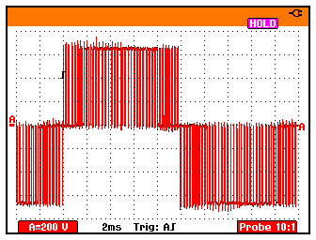
PWM waveform
In this 460 V ac drive,
the Pulse Width
Modulated waveforms
go from 0 to 650 V dc
in a microsecond or
less.
These fast rise and fall
times (high dV/dt)
have a lot of high
frequency content.
This could cause EMI
if the motor is not
grounded well.
Notes:
Explain FFT and how steep edges can have high frequency content.

Slide 34
Live Demo
We will use the Pico Scope 2204 oscilloscope for the projector display.
Current Probe is Tektronix A621 or A622.
Voltage Probe is Tektronix P5200, differential and isolated.
Battery scopes are Tektronix 720P and Fluke.

