Slide 1
MasterPact NW/NT Cat. Numbering System Based on PLS007
Page 1 of 2
4
DC
 | UL - DC |  |  | ANSI – DC (General Purpose) |  |  | IEC - DC
Char | AIR Code | L/R: 8 ms | Cons | AIR Code | L/R: 13 ms (800-3000 A), 11 ms (4000 A) | Cons | AIR Code | L/R: 5/15/30 ms | Cons
1 | N | 500V: 35 kA | NW-type C | N/NA | 300V: 25 kA/ 800 A, 50 kA/ 1600-2000 A | NW-type C | N | 500V: 85/35/25 kA | NW-type C
2 |  |  |  | N/NA | 300V: 75 kA/ 3000 A | NW-type ? | H/HA | 500V: 100/85/50 kA | NW-type C
3 | H | 500V: 85kA | NW-type C | N/NA | 300V: 100kA/ 4000A | NW-type ? | H/HA | 500V: 100/85/50 kA 750V: 85/50/50 kA 900V: 85/35/25 kA | NW-type D
4 | H |  |  |  |  |  | H/HA | 500V: 100/85/50 kA 750V: 85/50/50 kA 900V: 85/35/25 kA | NW-type E
5 | N | 500V: 35 kA | NW-type C1 series
6 | H | 500V: 85 kA | NW-type C1 series
7 | N | 500V: 35 kA | NW-type C1 split
8 | H | 500V: 85 kA | NW-type C1 split
AC
DC
Type C: 3P construction, load is connected between pole A and C (500 Vdc)
Type C1 - Split: 3P construction, load is connected between pole A and C (center pole to split 2 batteries 300 VDC). (600 Vdc)
or
Type C1 – Series: 3P construction, load is connected between pole B and C (A and B poles are connected in series) (600Vdc)
Type D: 3P construction, load is connected between pole (A+B) and C (900 Vdc)
Type E: 4P construction, load is connected between pole (A+B) and (C+D) (900 Vdc)
AC
PLS007 Rev 25.PPT 7-08-2014

Slide 2
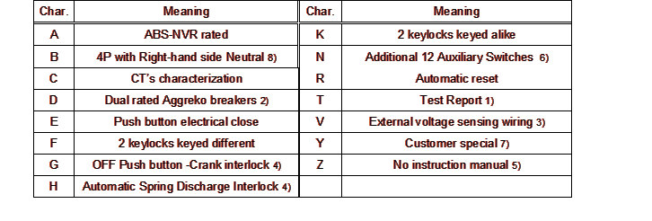
MasterPact NW/NT Cat. Numbering System Based on PLS007
Page 2 0f 2
.
PLS007 Rev 25 PPT 7-08-2014

