Slide 1
Ecostruxure Power Build – Rapsody INT V2.1.2 Registration & Login
Notes:
This is an example of a Title Slide. We need to convey Life Is On in everything we do, so try to lead with compelling images that are vibrant, authentic, and human. The human element should be apparent and within the context of a segment that we touch.
To keep this PowerPoint template file size reduced, we included a small library of image choices in the Slide Master (under View). You can also get them from the SE Asset Library: https://schneiderelectric.telescopeondemand.com

Slide 2
Legacy Registration Method – Slide 3
New Registration Method – Slide 5
Login - Slide 9
Reset Password – Slide 10
Notes:
Agenda slide

Slide 3
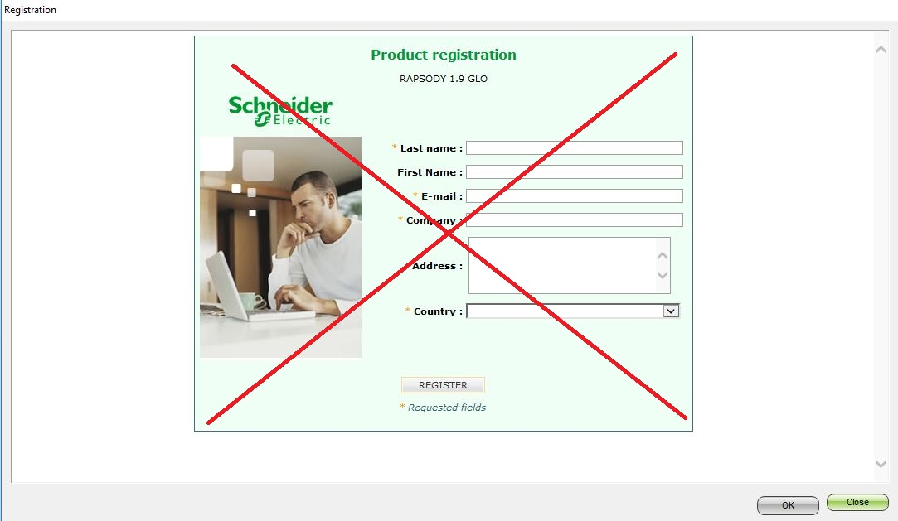
Legacy Registration Method
This is the old method of registration to Rapsody upto GLO V 1.9.0 EN. This has changed from INT V2.1.2 onwards
Notes:
This is an example of a Text Slide. Reference the different layout options in the Slide Master (under the View tab) for different variations. Remember, our new Brand Guidelines call for clean and simple messages and design. Reference the PowerPoint Guidelines on the Brand Book for tips and useful information on creating effective presentations.

Slide 4
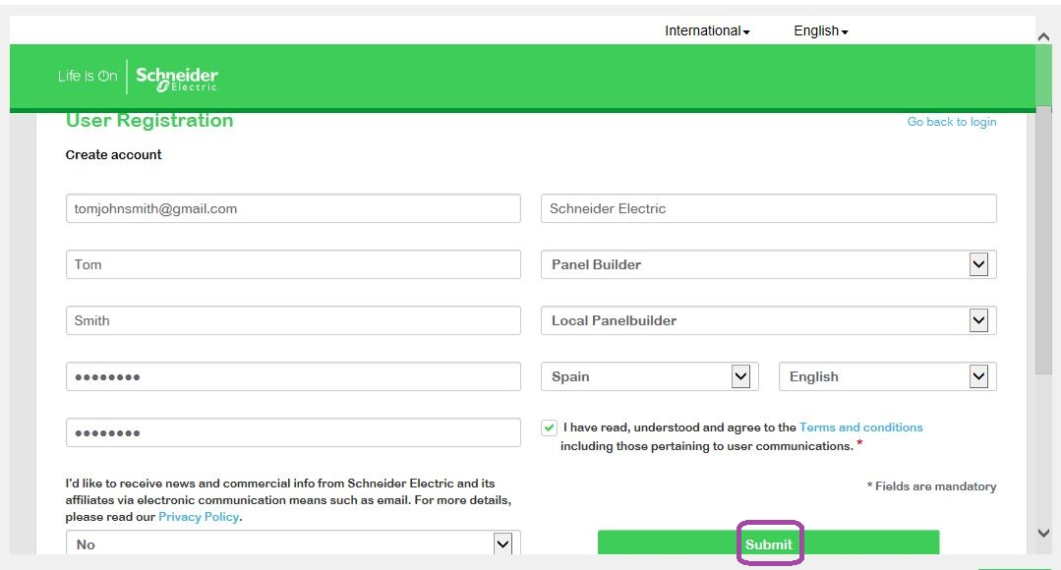
Legacy Registration Method to New Registration
Legacy Registration Method
New Registration Method

Slide 5
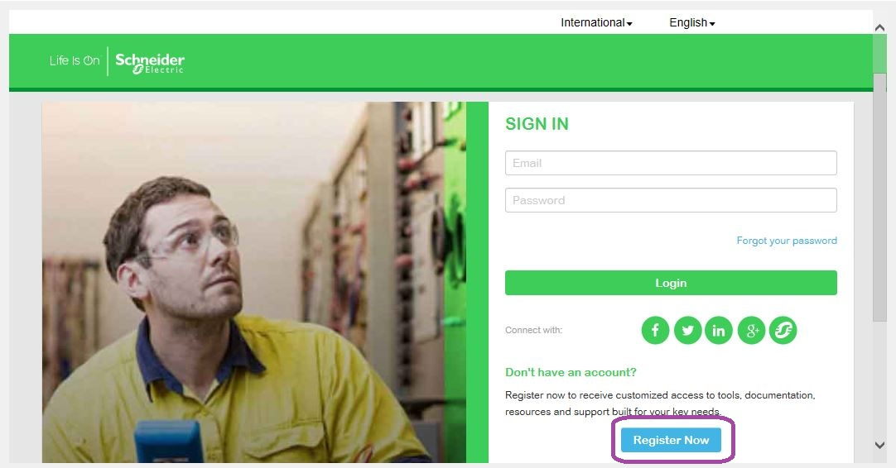
New Registration
From INT V2.1.2 onwards Rapsody is known as Ecostruxure Power Build – Rapsody & we have a new registration method.
In the Rapsody authentication window , Click on Register Now
Notes:
This is an example of a Text Slide. Reference the different layout options in the Slide Master (under the View tab) for different variations. Remember, our new Brand Guidelines call for clean and simple messages and design. Reference the PowerPoint Guidelines on the Brand Book for tips and useful information on creating effective presentations.

Slide 6
New Registration
Complete all the fields. Click on the Submit button. Make sure you provide an email to which you have access.
Password should contain at least 8 characters with at least one special, uppercase, lowercase and numeric character, and no more than two identical characters in a row.
Notes:
This is an example of a Text Slide. Reference the different layout options in the Slide Master (under the View tab) for different variations. Remember, our new Brand Guidelines call for clean and simple messages and design. Reference the PowerPoint Guidelines on the Brand Book for tips and useful information on creating effective presentations.

Slide 7
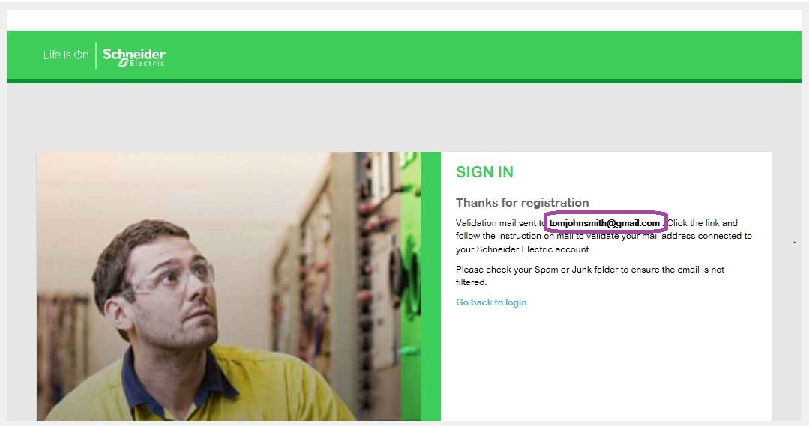
New Registration
1st Step of Registration is now complete. A mail will be sent to the email entered during registration process
Notes:
This is an example of a Text Slide. Reference the different layout options in the Slide Master (under the View tab) for different variations. Remember, our new Brand Guidelines call for clean and simple messages and design. Reference the PowerPoint Guidelines on the Brand Book for tips and useful information on creating effective presentations.

Slide 8
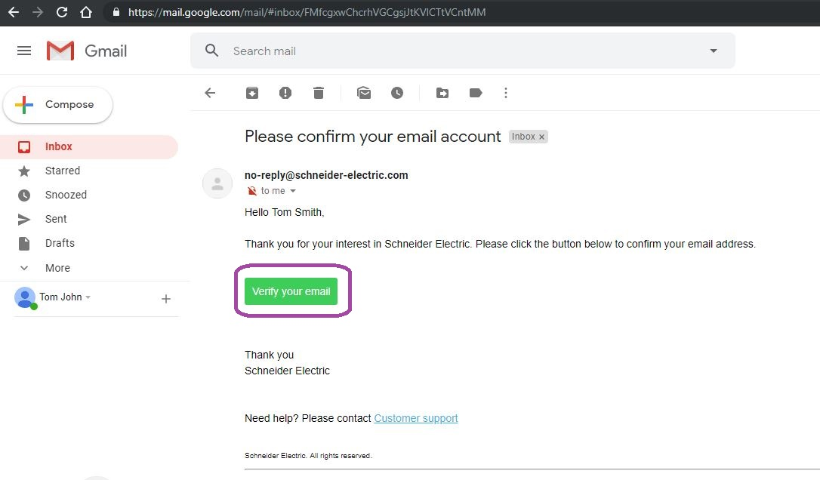
New Registration
2nd Step of Registration. Go to your email inbox & open the email from Schneider Electric.
Click on “Verify your email”.
Notes:
This is an example of a Text Slide. Reference the different layout options in the Slide Master (under the View tab) for different variations. Remember, our new Brand Guidelines call for clean and simple messages and design. Reference the PowerPoint Guidelines on the Brand Book for tips and useful information on creating effective presentations.

Slide 9
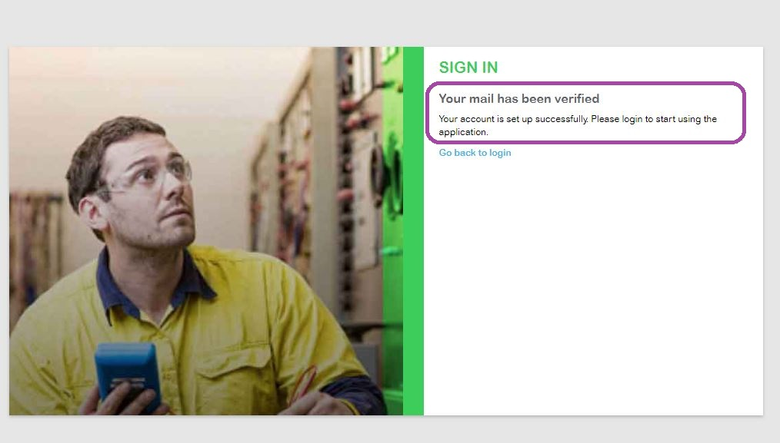
New Registration
You will be redirected to a page with a message “Your mail has been verified”.
Notes:
This is an example of a Text Slide. Reference the different layout options in the Slide Master (under the View tab) for different variations. Remember, our new Brand Guidelines call for clean and simple messages and design. Reference the PowerPoint Guidelines on the Brand Book for tips and useful information on creating effective presentations.

Slide 10
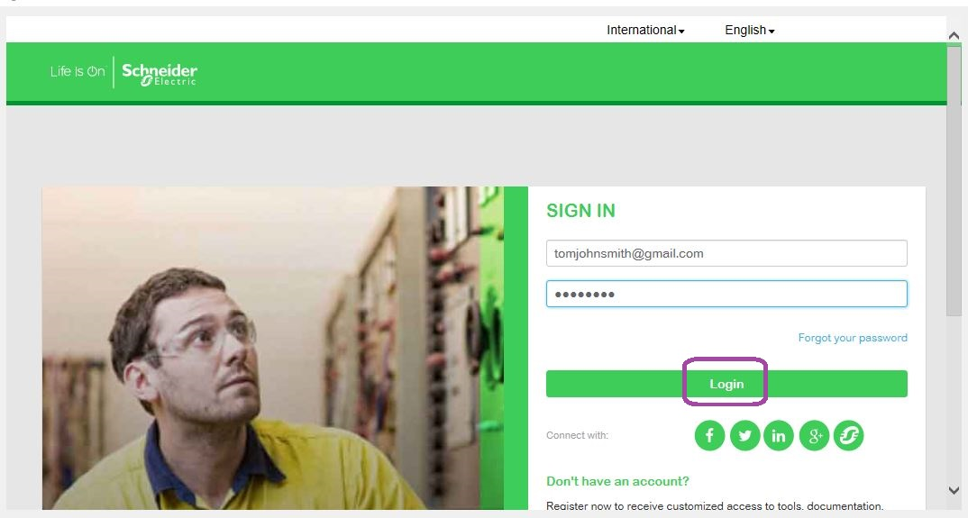
Login
Now you can Open the Rapsody Window. Enter your newly created & verified username & Password
You will be able to successfully login to Ecostruxure Power Build – Rapsody & start using the software.
Notes:
This is an example of a Text Slide. Reference the different layout options in the Slide Master (under the View tab) for different variations. Remember, our new Brand Guidelines call for clean and simple messages and design. Reference the PowerPoint Guidelines on the Brand Book for tips and useful information on creating effective presentations.

Slide 11
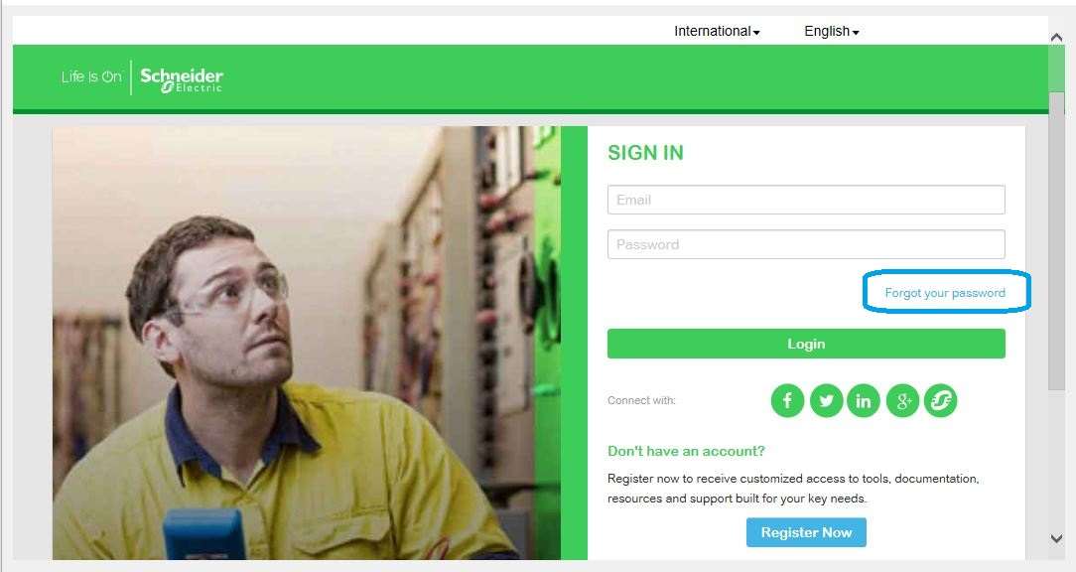
Reset Password
If you have forgotten your password – Click on the “Forgot your password” link to reset your password
Notes:
This is an example of a Text Slide. Reference the different layout options in the Slide Master (under the View tab) for different variations. Remember, our new Brand Guidelines call for clean and simple messages and design. Reference the PowerPoint Guidelines on the Brand Book for tips and useful information on creating effective presentations.

Slide 12
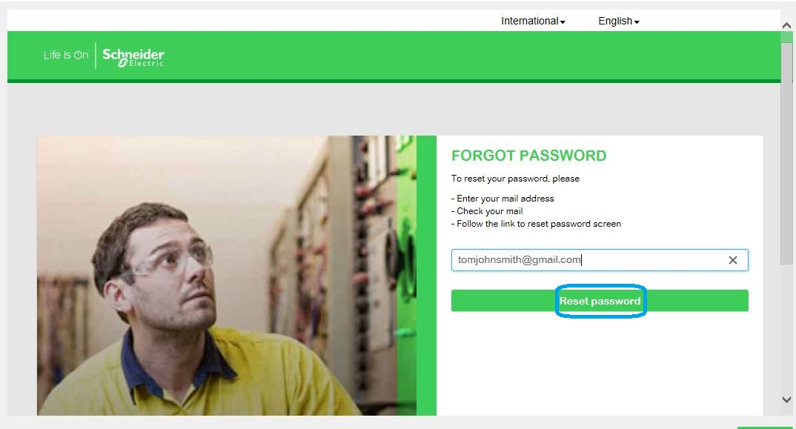
Reset Password
Enter your email address. Click on “Reset Password”. An email with a link to reset your password will be sent to your email address.
Notes:
This is an example of a Text Slide. Reference the different layout options in the Slide Master (under the View tab) for different variations. Remember, our new Brand Guidelines call for clean and simple messages and design. Reference the PowerPoint Guidelines on the Brand Book for tips and useful information on creating effective presentations.

Slide 13
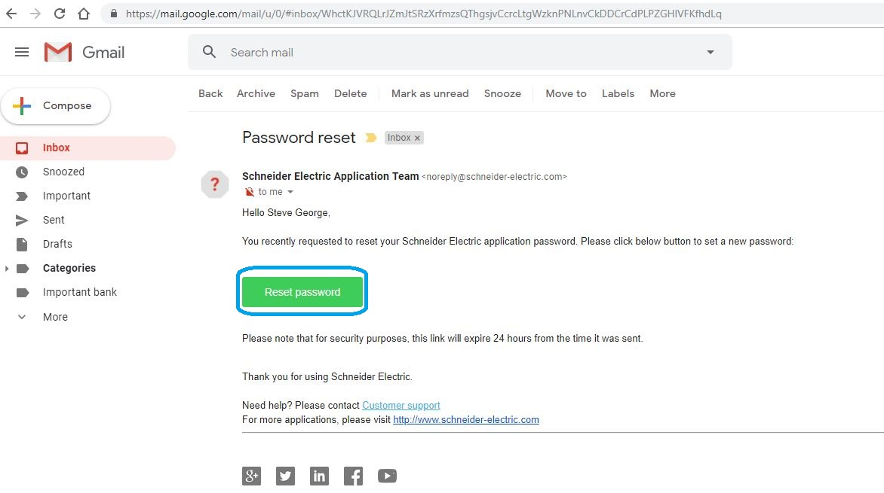
Reset Password
Open the email from Schneider Electric in your inbox. Click on “Reset Password”
Notes:
This is an example of a Text Slide. Reference the different layout options in the Slide Master (under the View tab) for different variations. Remember, our new Brand Guidelines call for clean and simple messages and design. Reference the PowerPoint Guidelines on the Brand Book for tips and useful information on creating effective presentations.

Slide 14
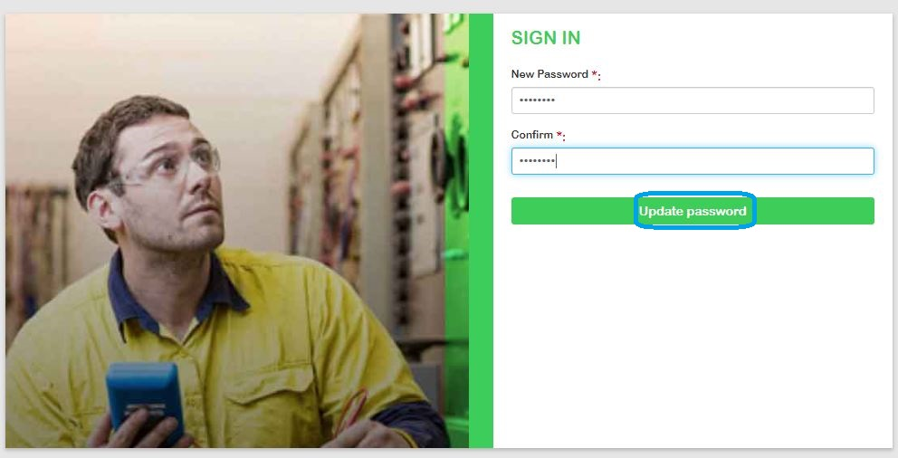
Reset Password
Enter the new password & confirm. Click on “Update Password”
Password should contain at least 8 characters with at least one special, uppercase, lowercase and numeric character, and no more than two identical characters in a row.
Notes:
This is an example of a Text Slide. Reference the different layout options in the Slide Master (under the View tab) for different variations. Remember, our new Brand Guidelines call for clean and simple messages and design. Reference the PowerPoint Guidelines on the Brand Book for tips and useful information on creating effective presentations.

Slide 15
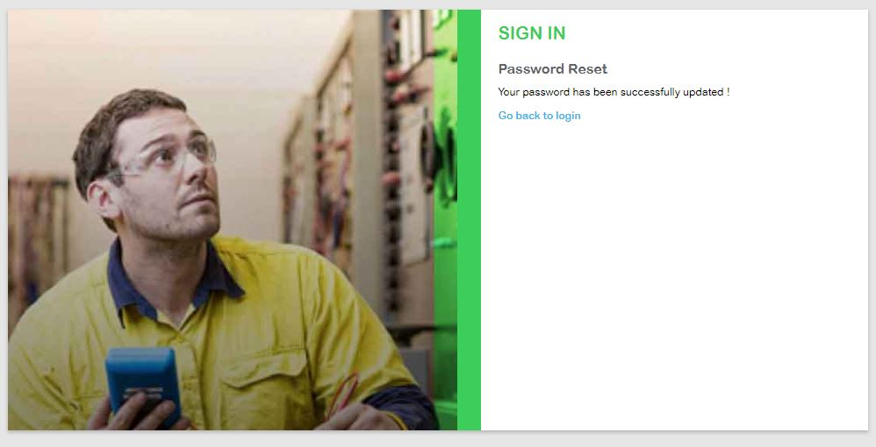
Reset Password
You will get this message which indicates that your password has been updated.Go back to Rapsody login screen & enter the username & password. This will enable you to use the Rapsody Software
Notes:
This is an example of a Text Slide. Reference the different layout options in the Slide Master (under the View tab) for different variations. Remember, our new Brand Guidelines call for clean and simple messages and design. Reference the PowerPoint Guidelines on the Brand Book for tips and useful information on creating effective presentations.

Slide 16
Notes:
Closing slide

