Slide 1

EcoStruxure Power Design- Ecodial
How to manually select the conductor size in Ecodial
Presented by: Rashmi Kumari
Schneider Electric

Slide 2
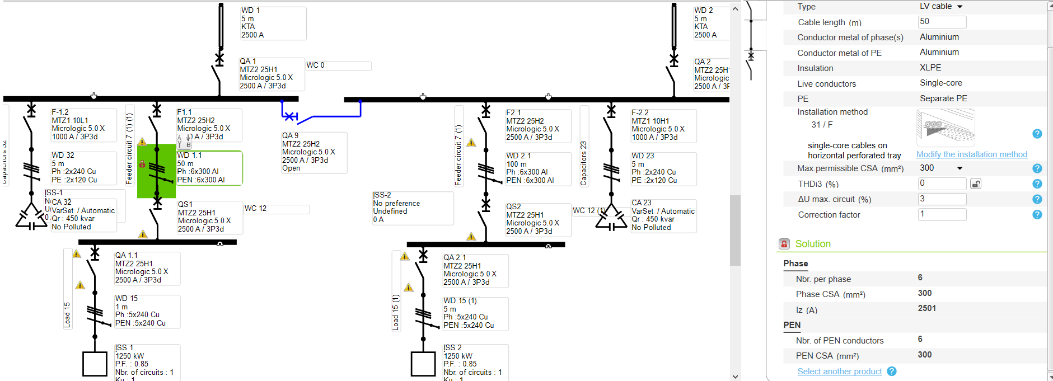
How to manually select the conductor size in Ecodial
Create a network
Provide cable parameters in properties tab by selecting cable in network area.
Calculate the network
Application will size cable conductor automatically based on sizing current and the cable installation method input which has was provided in the “ properties tab”

Slide 3
How to manually select the conductor size in Ecodial
Application has sized the cable
Ph- 6x300AL
PEN-6X300AL
Here maximum permissible CSA mm2 is selected as -300 sqmm
So, application has sized cable with 300 CSA with 6 runs .

Slide 4
How to manually select the conductor size in Ecodial
How to size cable conductors manually with different number of run and cross section for individual loads?
Lets consider ,If you want to select 400Sq. Mm cable for feeder.
Select particular load /feeder from network area
Select properties area
Click on ‘ maximum permissible CSA sq mm”
Cable CSA ,starting from 90sqm - 630sq mm will appear in drop down box
Select 400Sq.mm csble.
Calculate the project
Ecodial will size the cable based on the maximum permissible CSA which you have selected as 400sq. Mm and application will accordingly adjust the cable run based on sizing current .

Slide 5
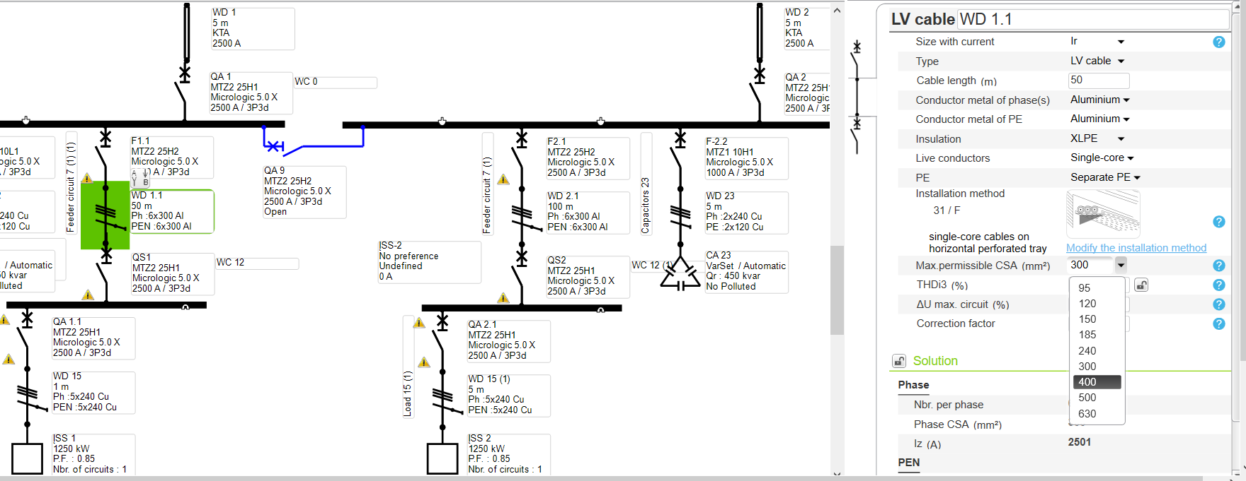
How to manually select the conductor size in Ecodial
Notes:
.

Slide 6
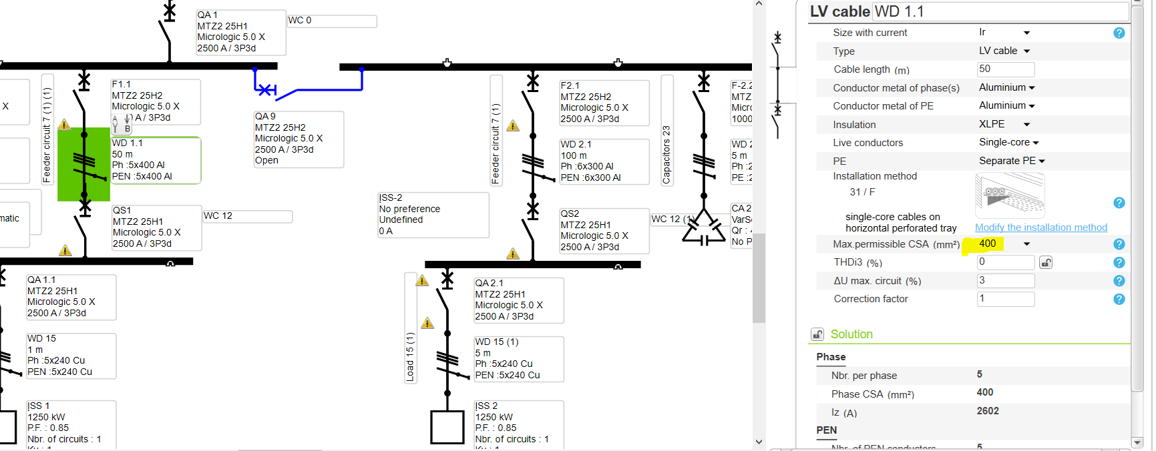
How to manually select the conductor size in Ecodial- Final Result
– Final result
Notes:
.

