Slide 1

EcoStruxure Power Design- Ecodial
In Ecodial , how to have modular contactors solution in Ecodial application so that user can choose the right solution?
Presented by: Rashmi Kumari
Schneider Electric

Slide 2
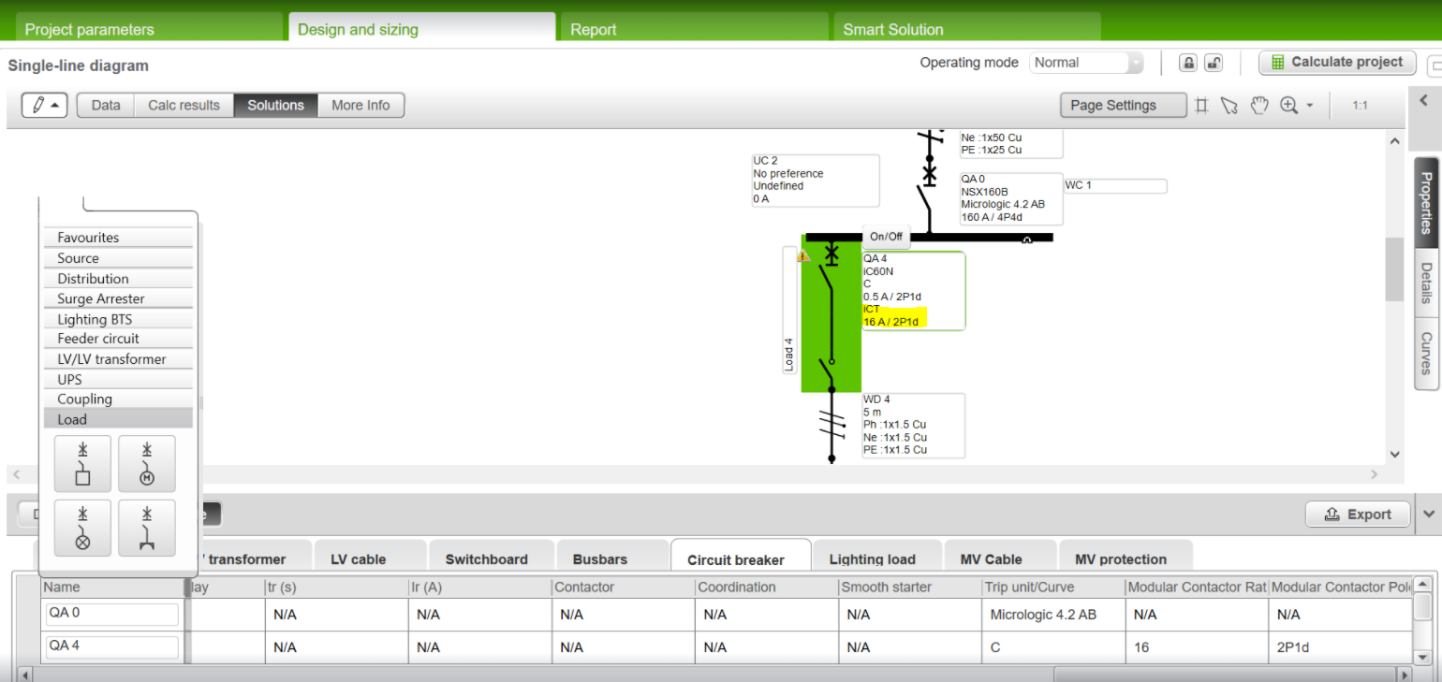
How to have modular contactors solution in Ecodial application so that user can choose the right solution!
if the user has selected ‘modular contactors = Yes, then a 'solution window’ should appear with the following fields:
  Contactor designation
  Rating (A)
  Poles

Slide 3
How to have modular contactors solution in Ecodial application so that user can choose the right solution!
  The same should appear as columns in the ‘Solution table’. Results will appear in rows

Slide 4
How to have modular contactors solution in Ecodial application so that user can choose the right solution!
  When Mod. contactor = yes; then circuit breakers with trip units B & C should be proposed

Slide 5
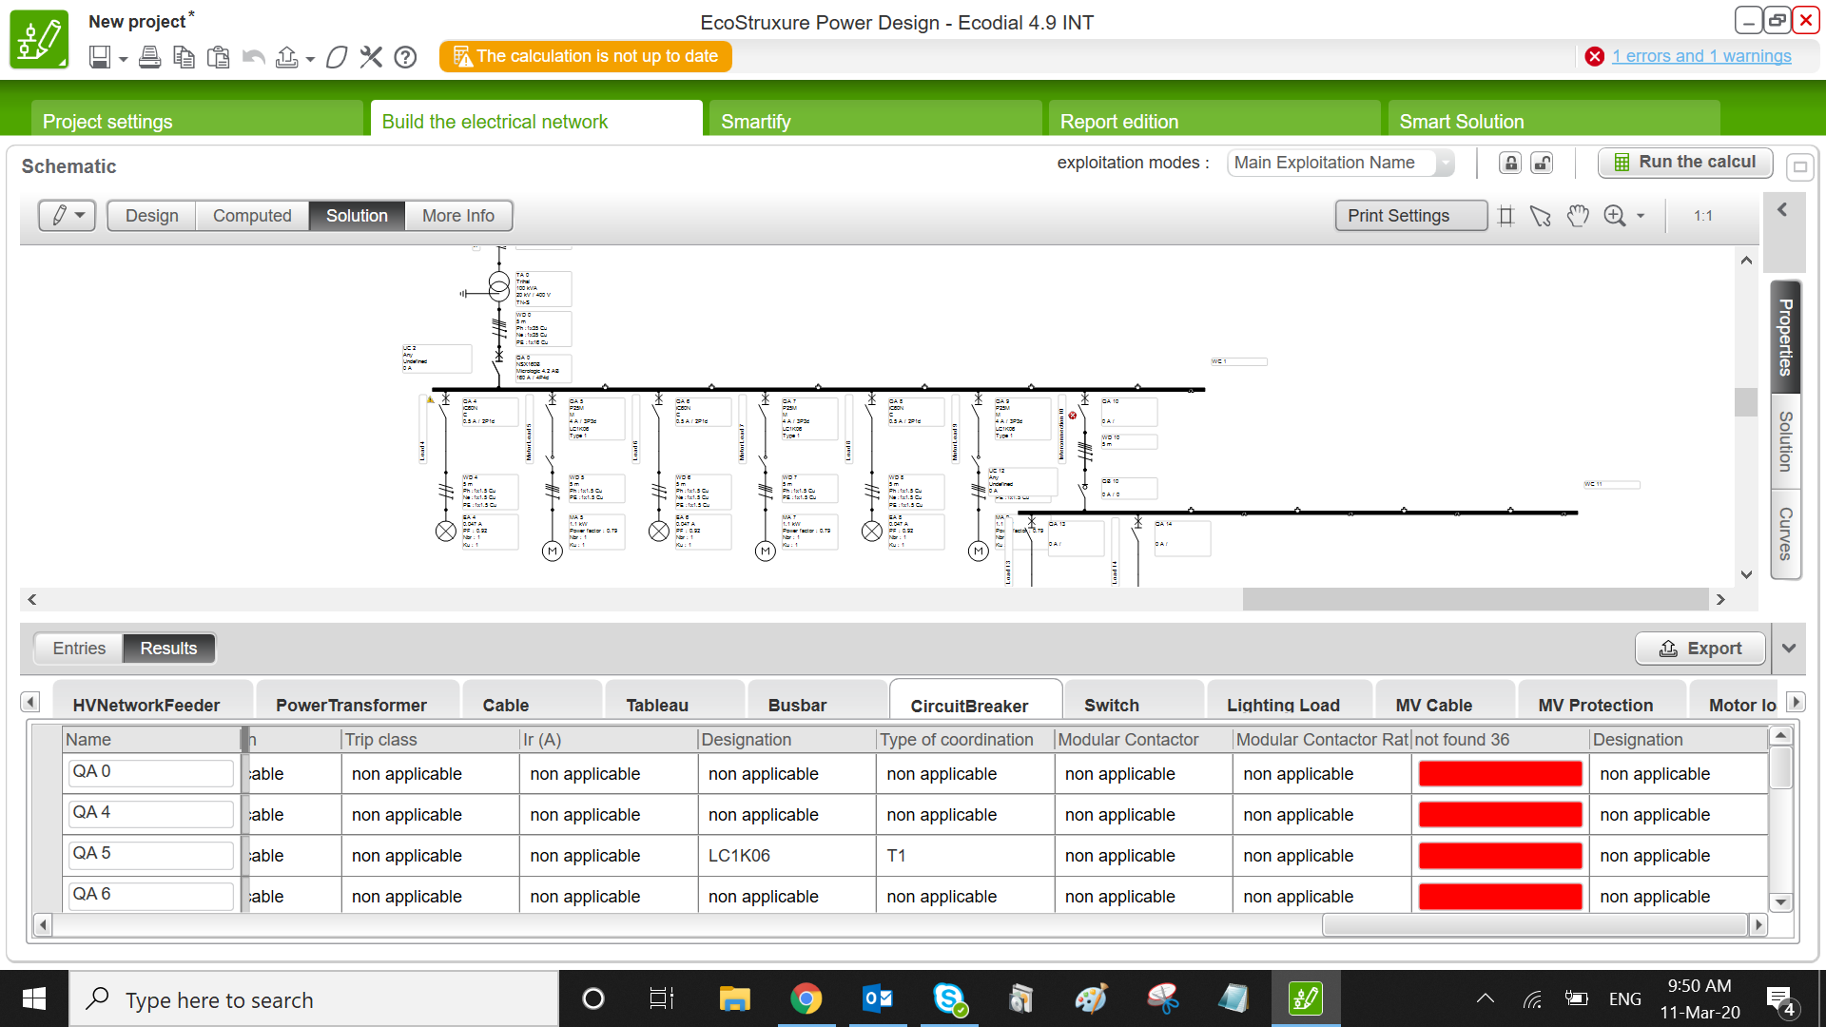
How to have modular contactors solution in Ecodial application so that user can choose the right solution!
if the solution is unable to find circuit breakers with trip unit B & C, then an error message should be displayed stating “unable to find a suitable circuit breaker…disable the Mod. contactor and then proceed”
if the user chooses a circuit breaker other than B & C, then error message should be displayed stating “Mod. contactor should be disabled as it doesn’t work with this trip unit”
Notes:
.

Slide 6
How to have modular contactors solution in Ecodial application so that user can choose the right solution!
NOTE: user will not have a choice to modify the output from Ecodial. No ‘manual choice’ controller for this solution .
Notes:
.

