Slide 1

BIOS Update
HMIBMU and HMIBMP

Slide 2
Purpose
Cfast for the following references will use now SATA3 technology:
HMIBMU
HMIBMP
OS Image will be updated in factory but for the existing products we need to perform manually the update of the BIOS in order to use the SATA3 Cfast cards.
This document describe the procedure on how to perform the bios update.

Slide 3
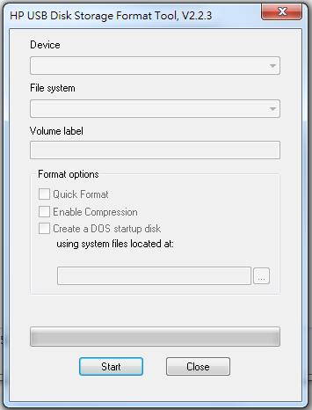
STEP 1: Use HPUSBDisk Utility to make USB boot disk

Slide 4
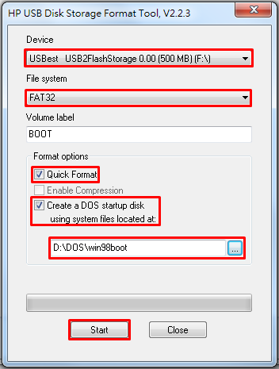

Step 2: Select USB device
Step 3: Select FAT32 format
Step 4: Select Quick Format
Step 5: Select Create a DOS startup disk.
Step 6: Extract win98boot.zip and select win98boot folder
Step 7: Start
=> 3 files are copied to the USB stick

Slide 5
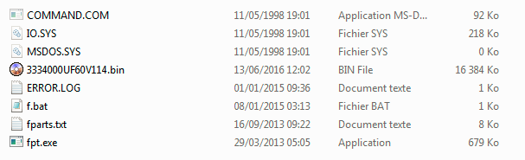
Step 8: Extract the update 7zip file P114.7z
Step 9: Copy/Paste the content of the P114.7z to the USB key.
You must have now the following content in your USB key:

Slide 6
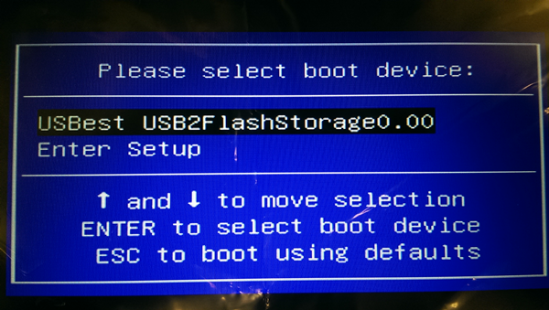
Step 10: Press “ F7 ” when boot up.
Step 11: Select USBest USB2FlashStorage0.00

Slide 7
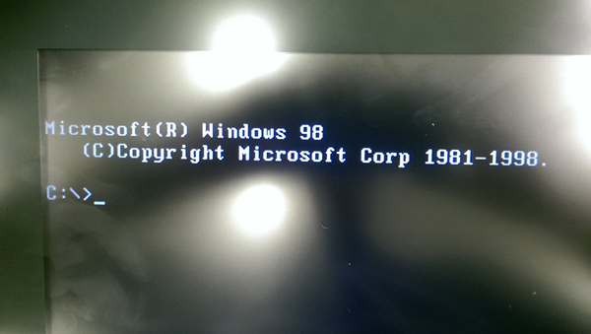
Step 12: A screen with windows 98 DOS mode prompt, appears

Slide 8
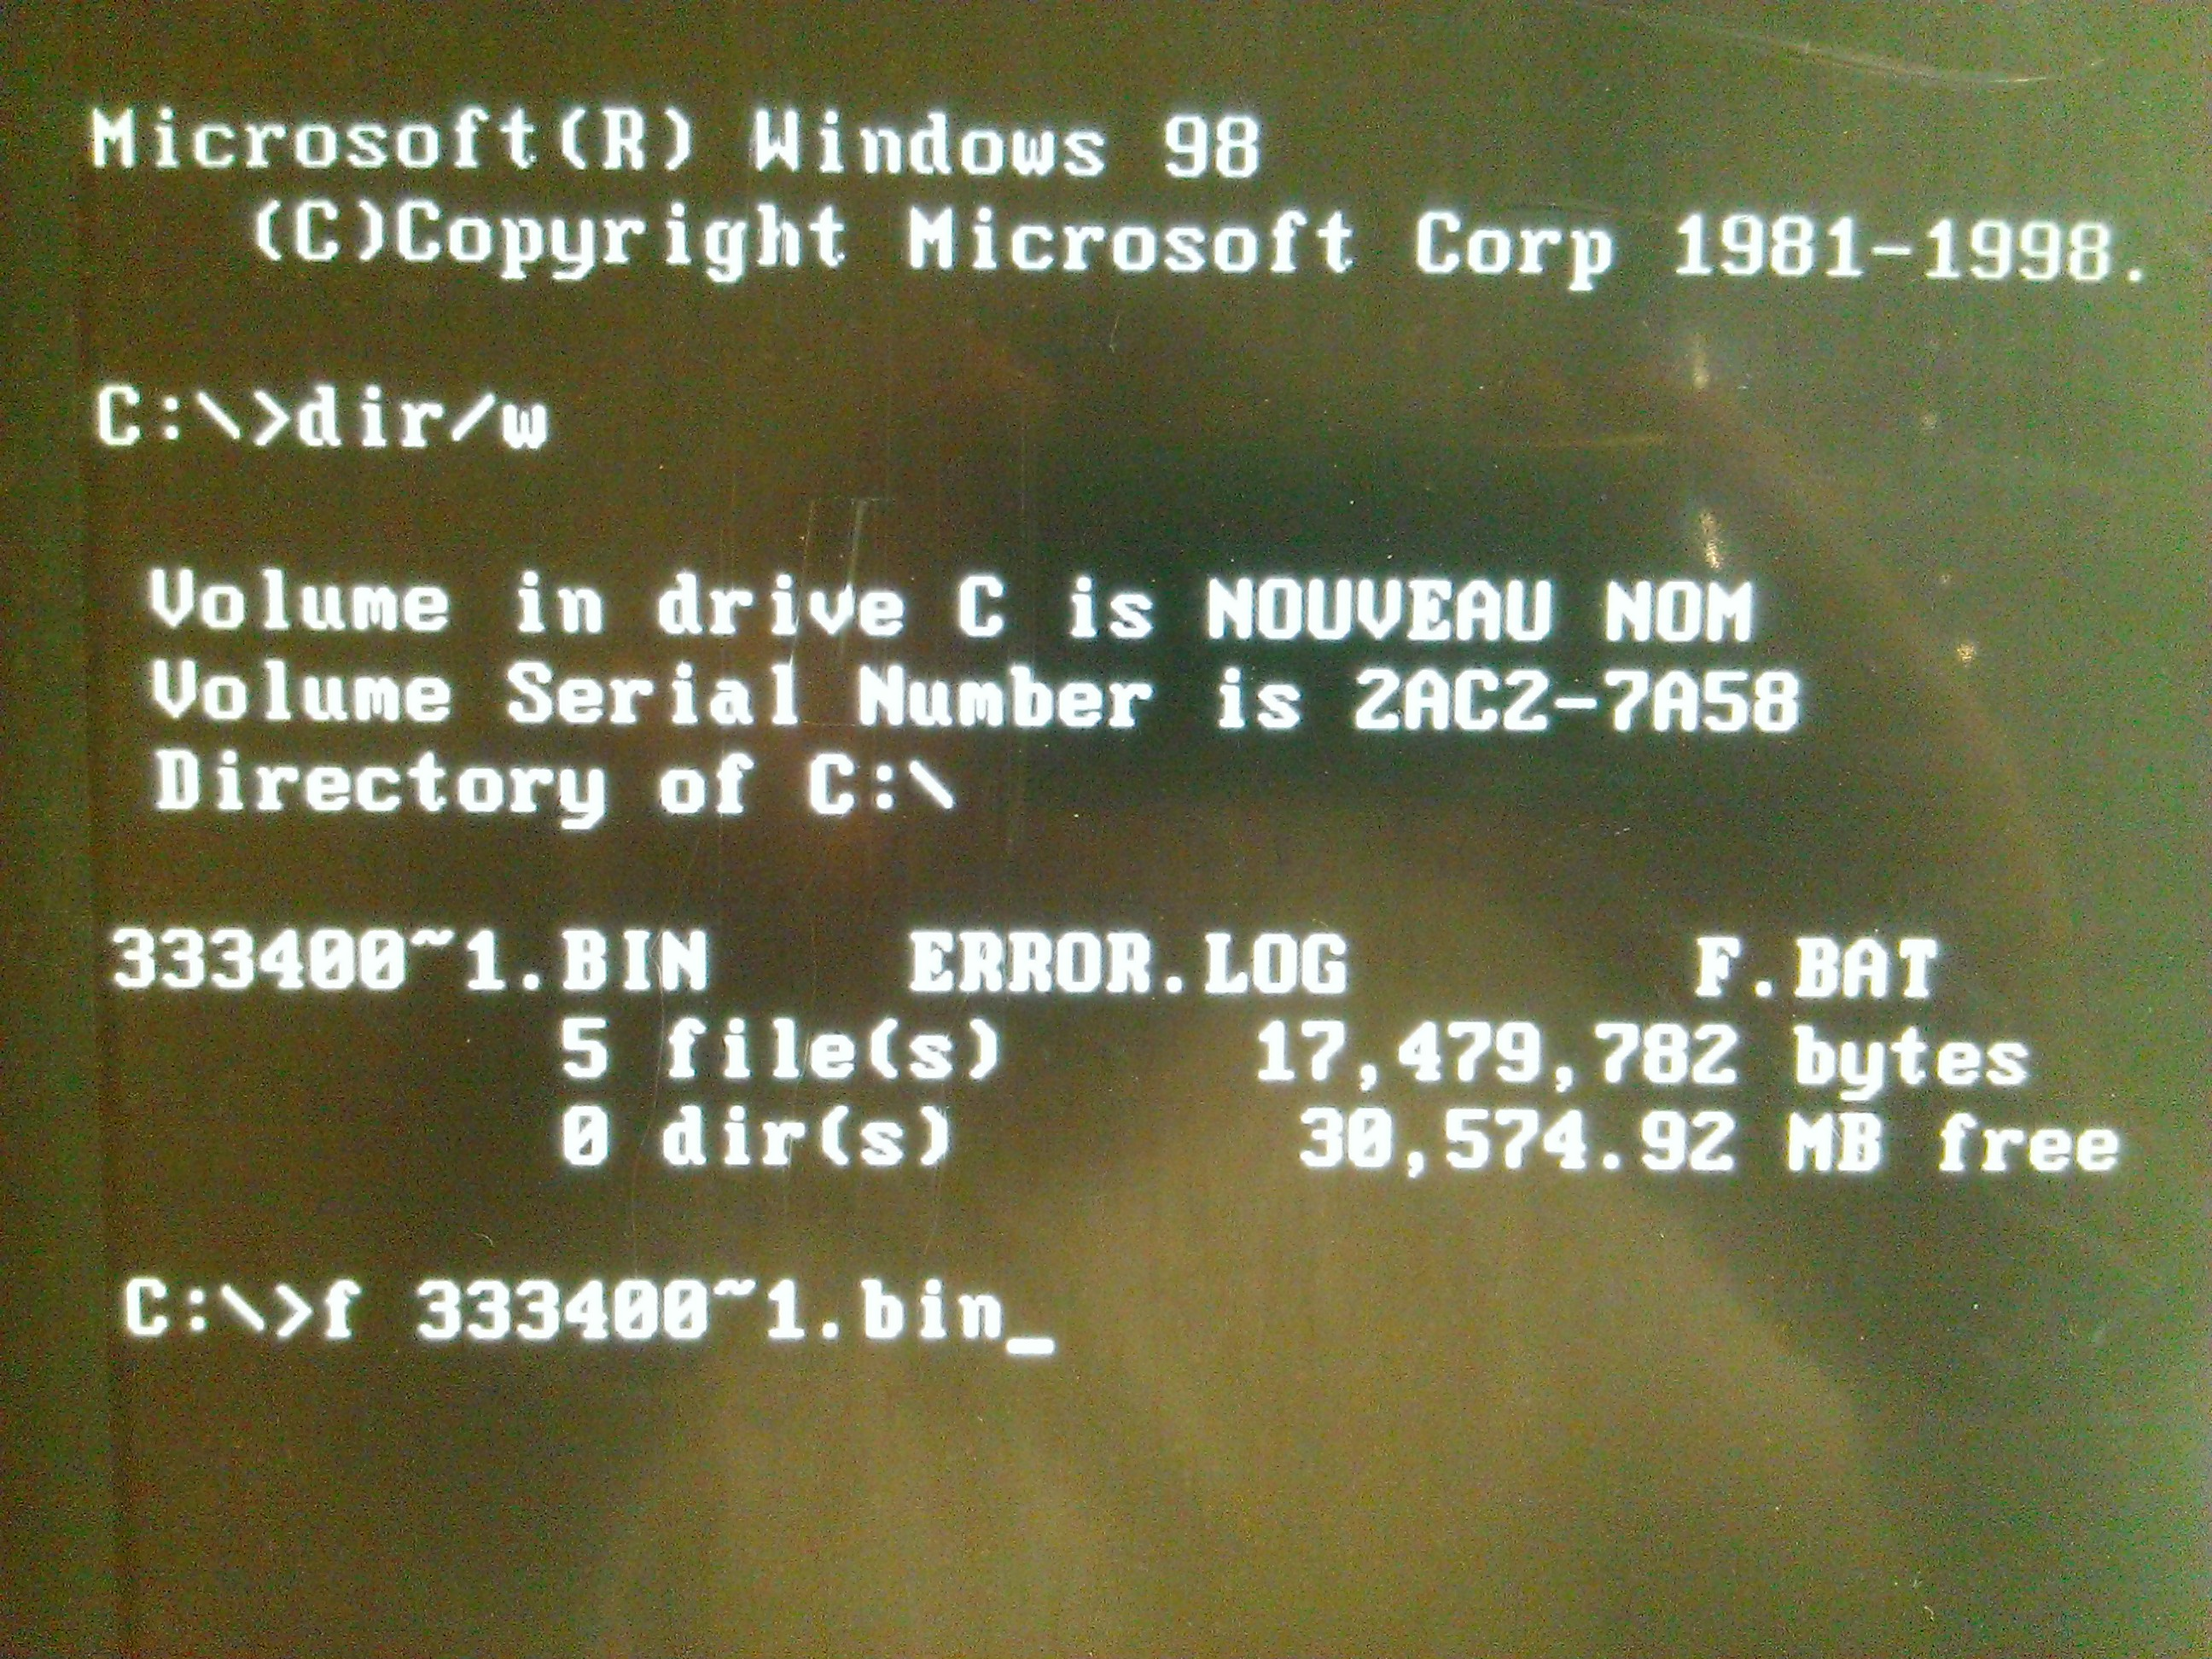
Step 13: To know the right name of the bin file, make a dir/w
Step 14: Then launch the procedure with: f 333400~1.bin

Slide 9
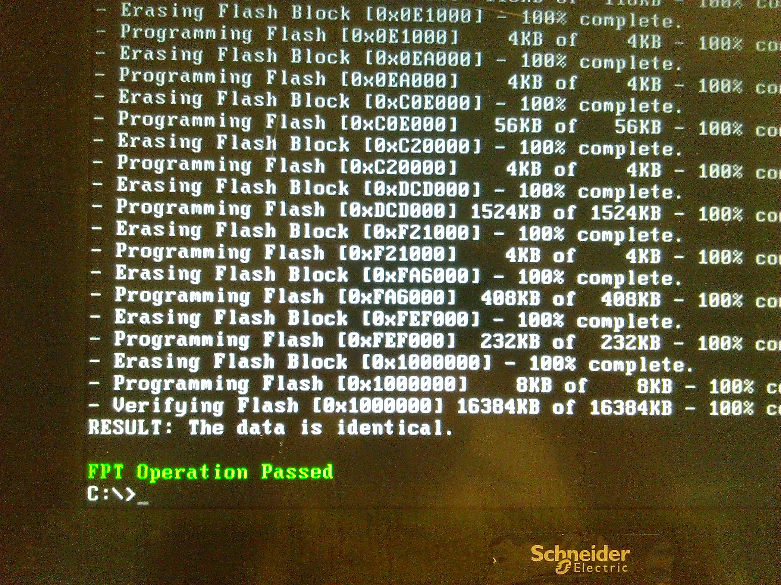
When operation is done, you must read:
FPT Operation passed

Slide 10
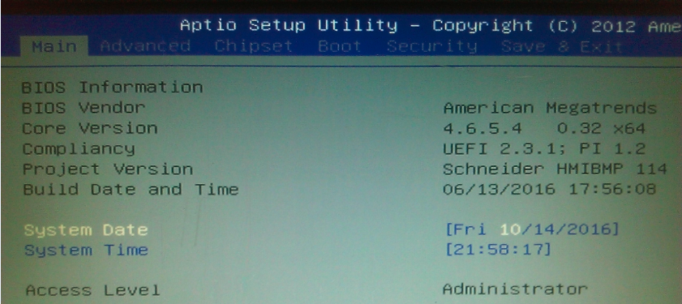
Step 14: To check that everything is fine,
- Restart the target
- Click on F2 or DEL
- Check the Project Version is well 114: i.e. Schneider HMIBMP 114 => it’s OK.

