Slide 1

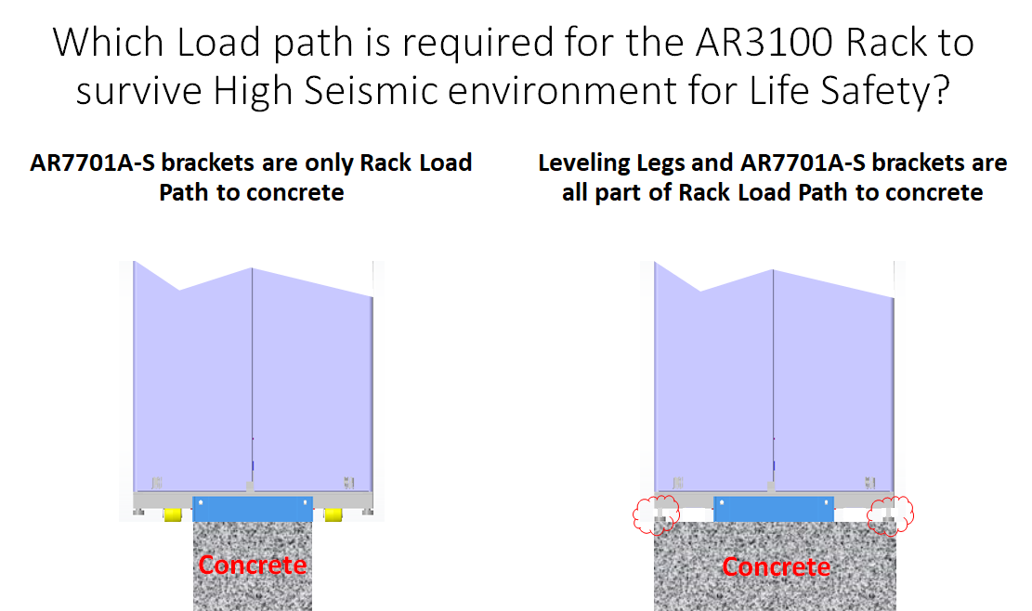
Does IBC High Seismic Area or OSHPD installation with NetShelter SX cabinets require the leveling feet to be lowered?
The calculations are all based on the anchorage points in the floor and the cabinet, but as in any installation it’s always the best practice (recommended) to have the leveling feet down.

