Slide 1
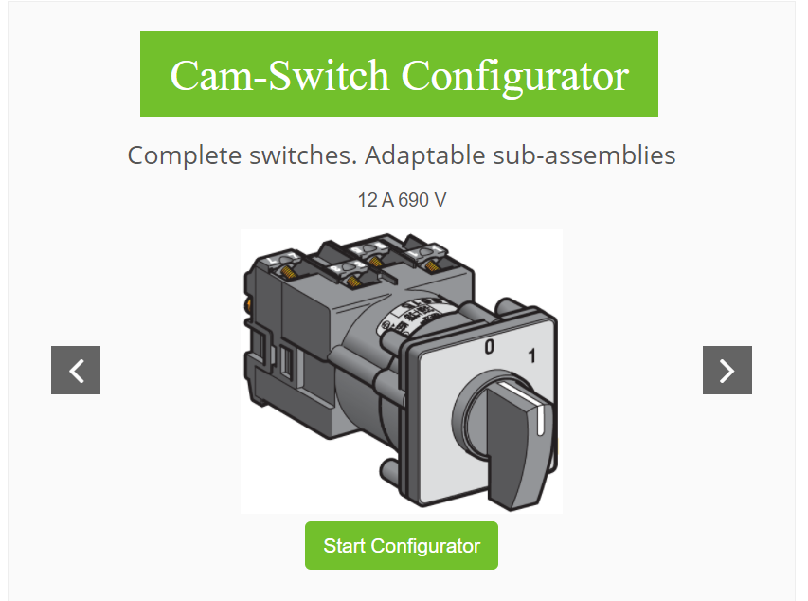
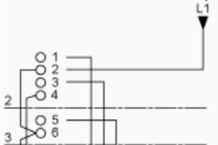
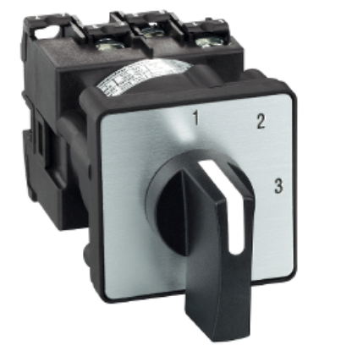

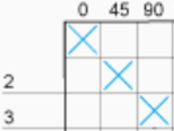
Cam Switch Configurator 1/4
Example : reproduce a K1C003NLH :
Link: https://www.camswitch-configurator.com

Slide 2
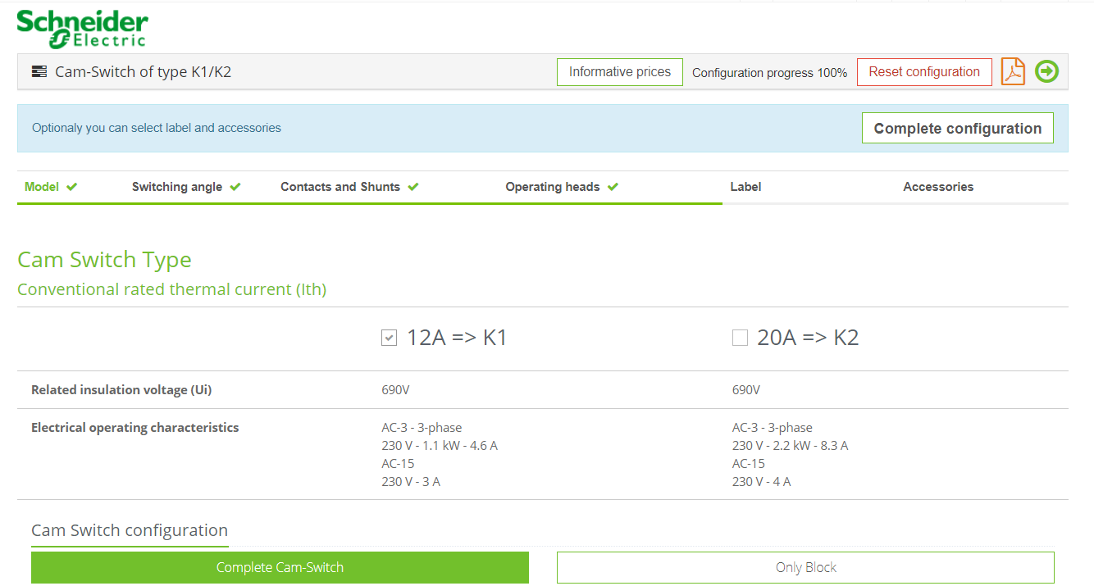
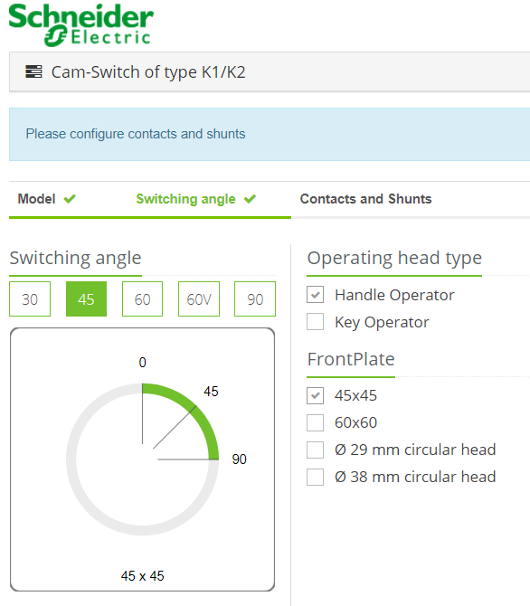
Cam Switch Configurator 2/4

Slide 3
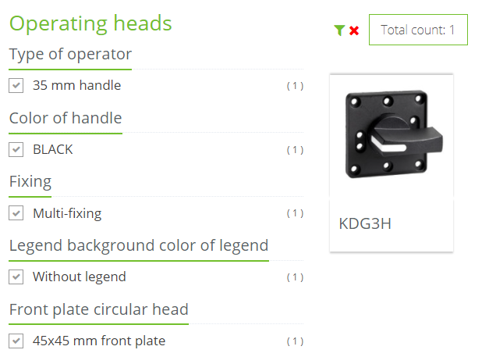
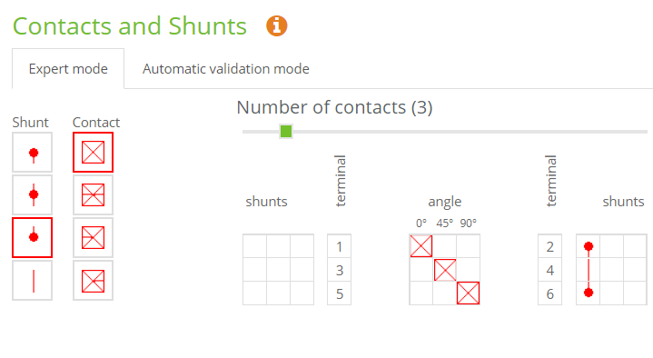
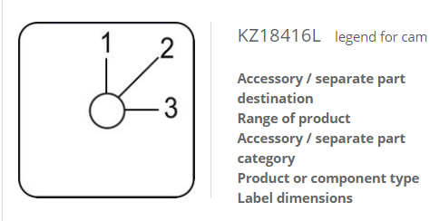
Cam Switch Configurator 3/4
Head & legend

Slide 4
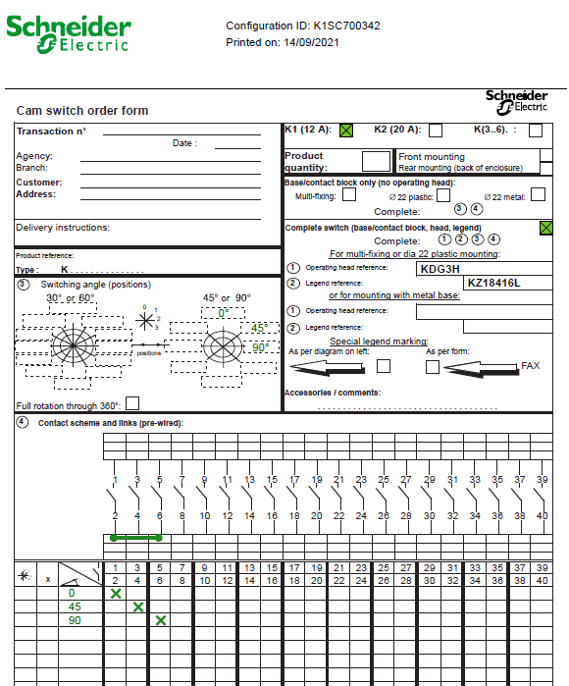
Cam Switch Configurator 4/4
K1/K2 order form:
This product should be ordered under
the radial K1S and the configuration ID :
K1SC700342

