Slide 1
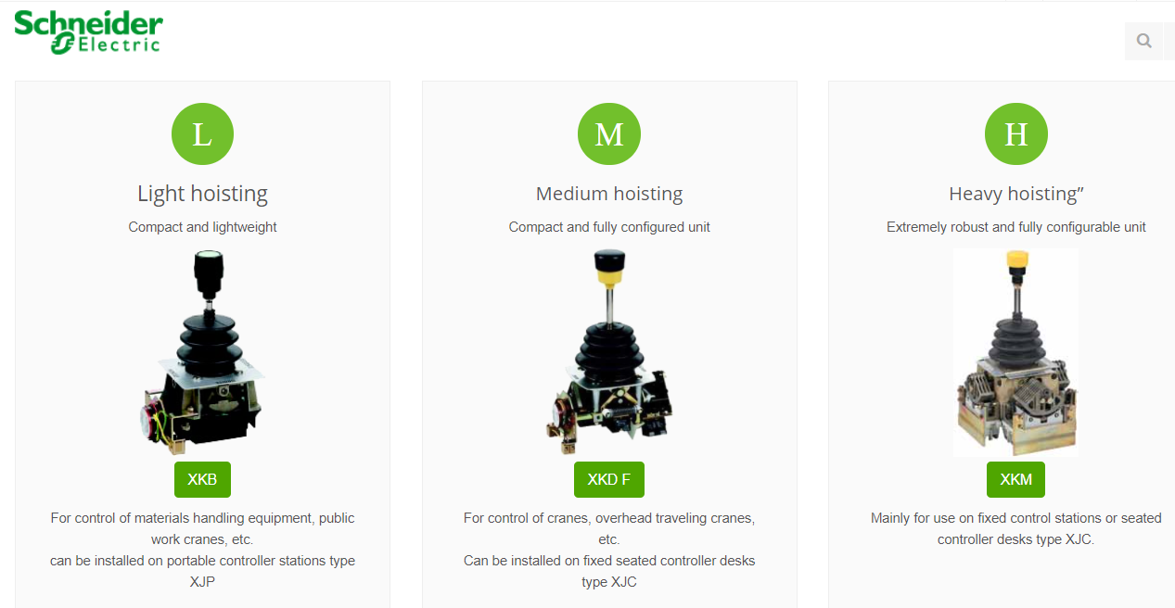
XK Configurator 1/4

Slide 2
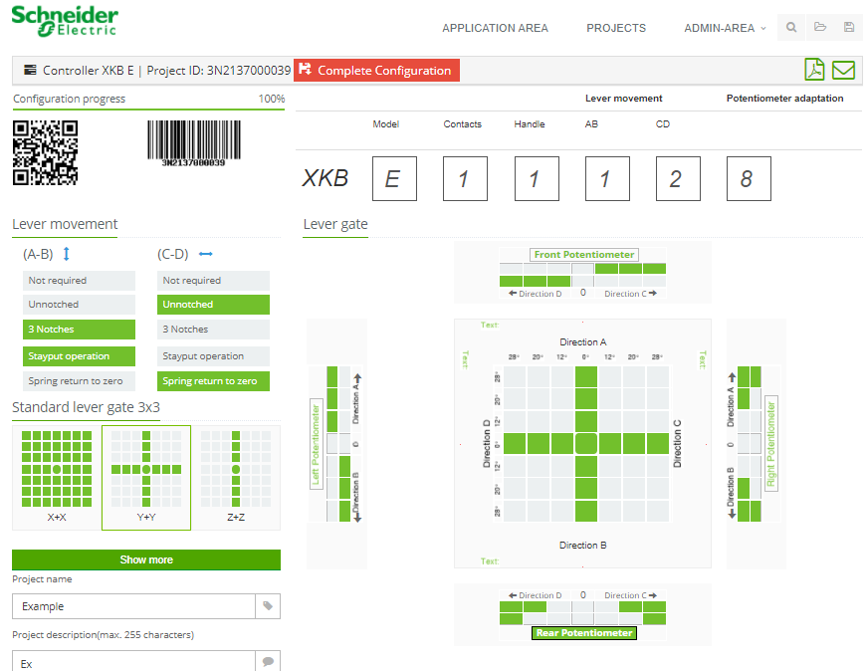
XK Configurator 2/4
Choose :
- Model
- Notches / Spring return
- Contact positions
- Lever gate
- Handle
- Potentiometer

Slide 3
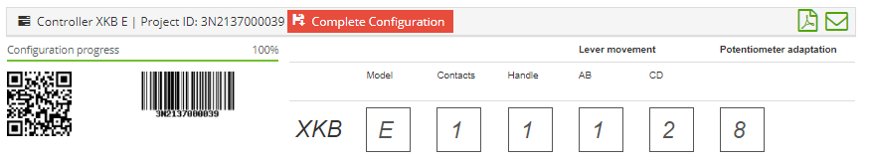
XK Configurator 3/4
The software provide a project ID with a QR and bar code :
After that click an the pdf icon

Slide 4
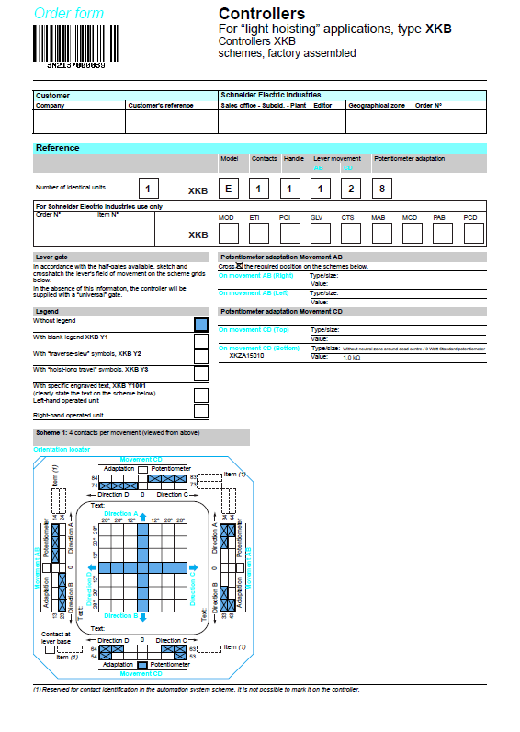

XK Configurator 4/4
It generate the product’s scheme
You can also send the configuration by e-mail

